Slide 1
Soft Computing Techniques
Unit-2

Slide 2
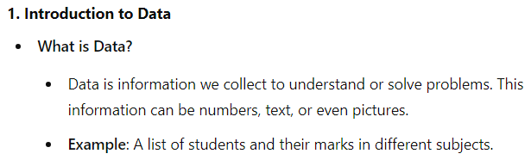
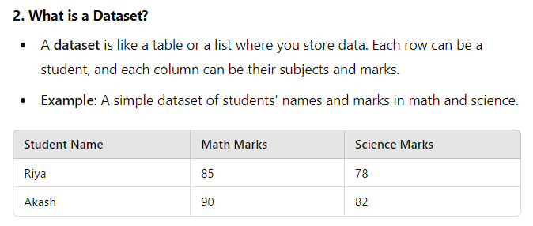
Before starting with ANN, let’s understand basics of Data Science.

Slide 3
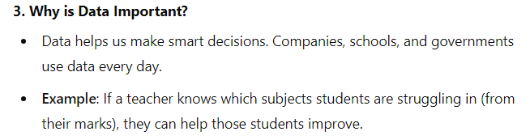
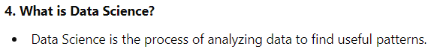
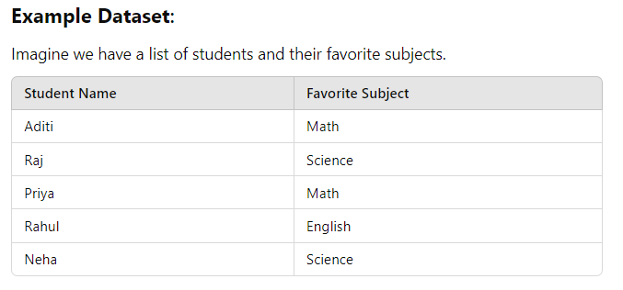

Slide 4
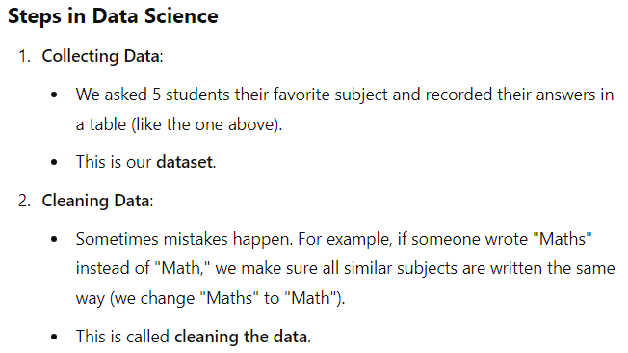
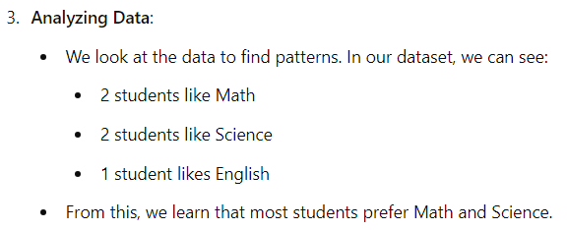

Slide 5
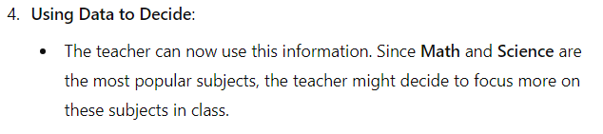
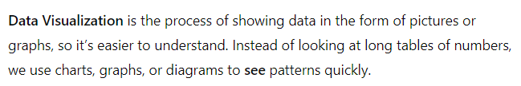
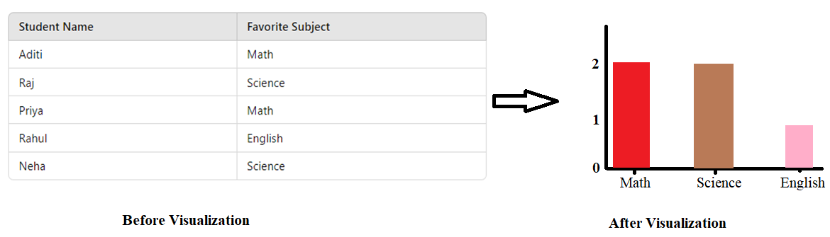
Now, coming to data visualization:-

Slide 6
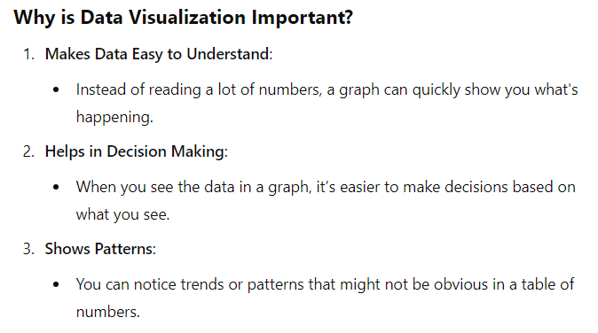

Slide 7
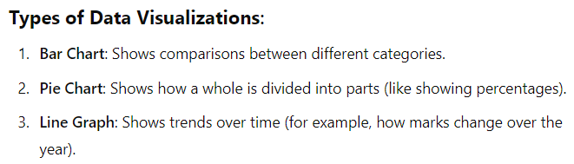
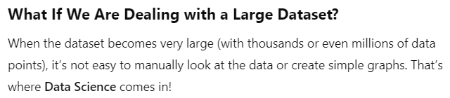


Slide 8
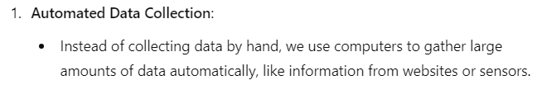
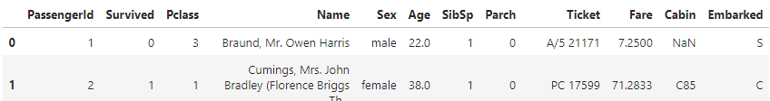
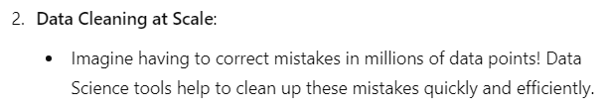


Slide 9
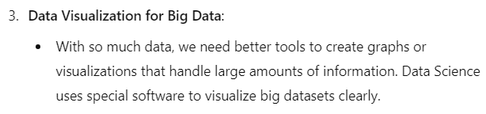
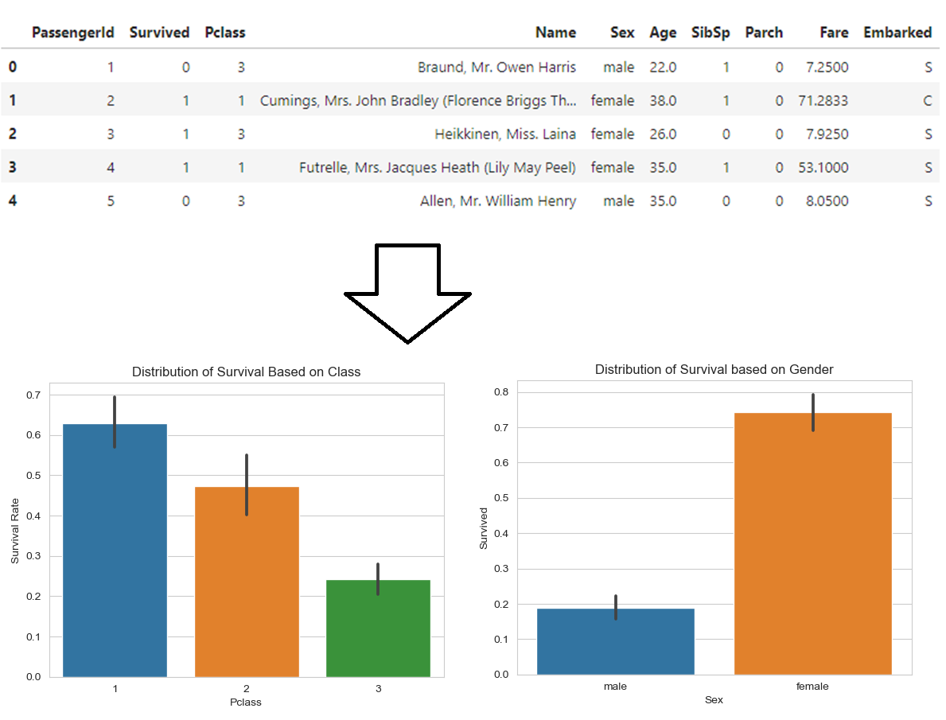
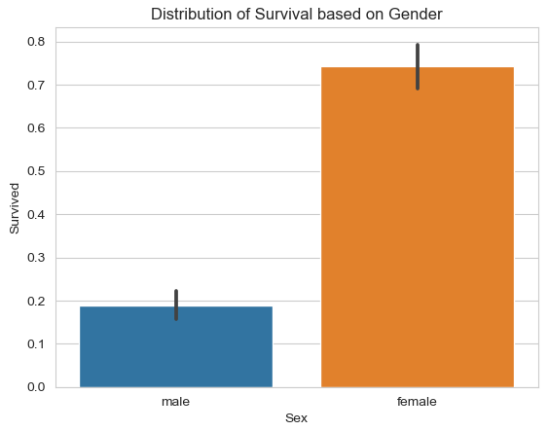
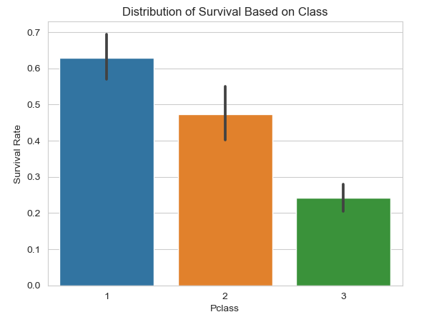

Slide 10
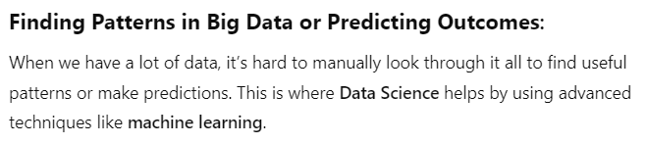
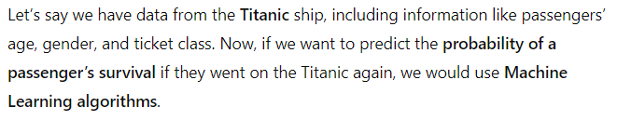
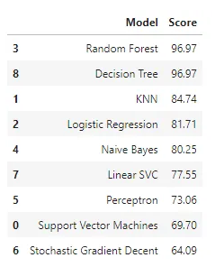
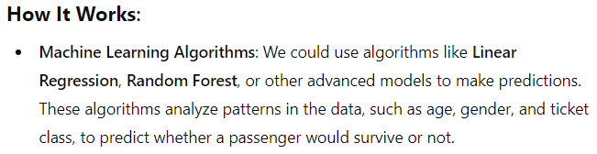

Slide 11
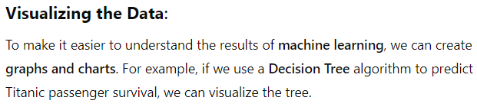
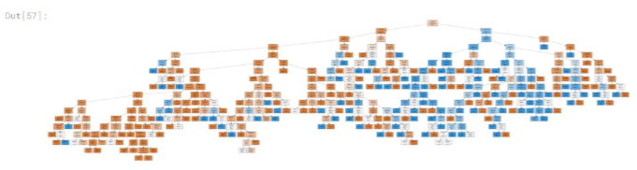

Slide 12
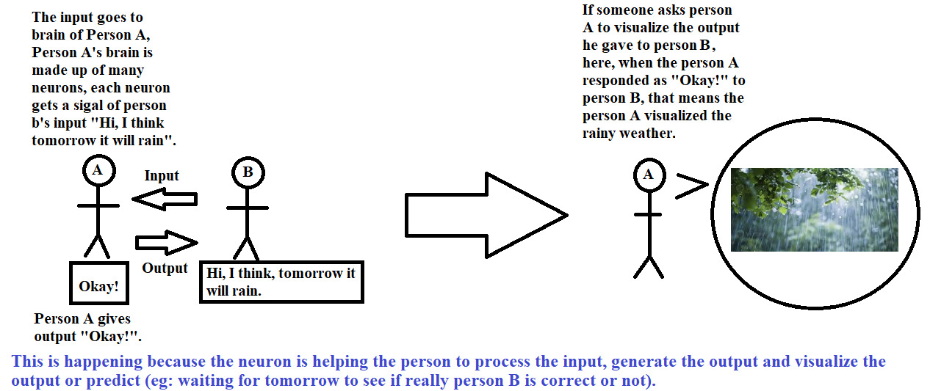
Now, coming to Neurons in humans:-

Slide 13
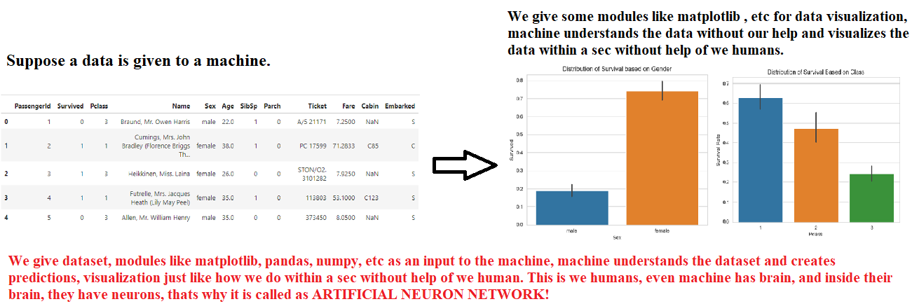
Now, coming to Artificial Neural Network:-

Slide 14
Artificial Neural Network

Slide 15
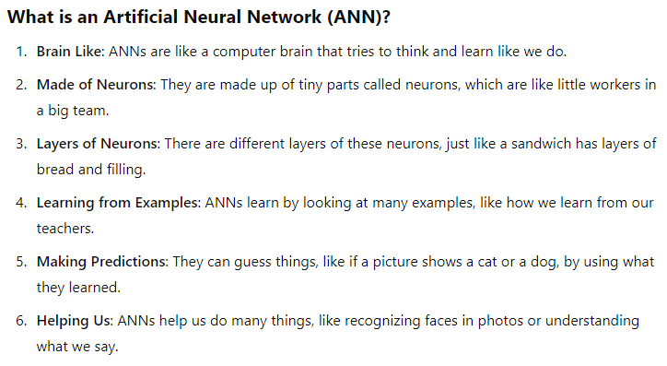

Slide 16
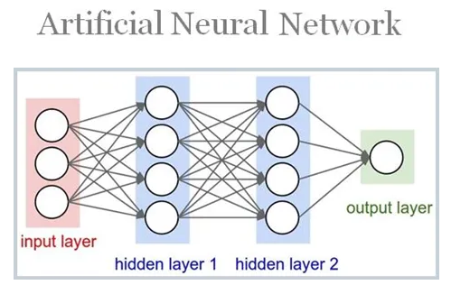
Fundamental Concept

Slide 17
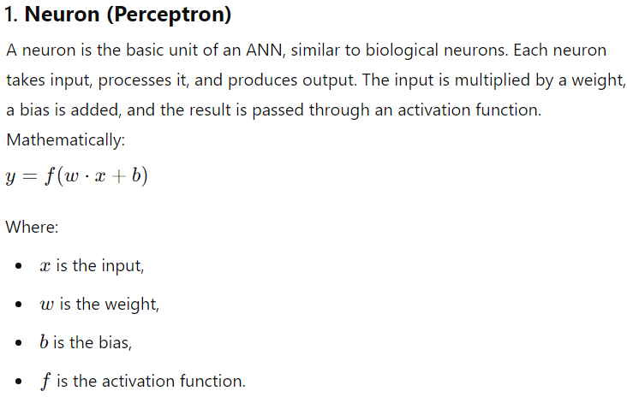

Slide 18
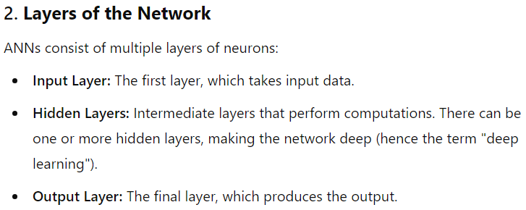
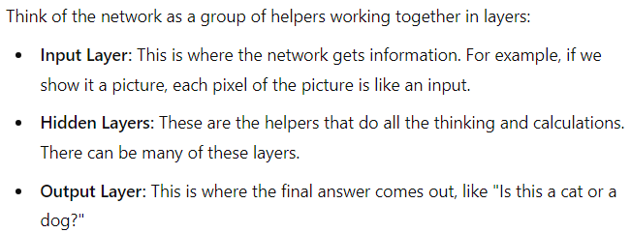

Slide 19
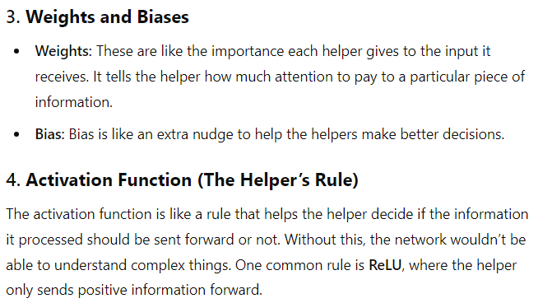

Slide 20
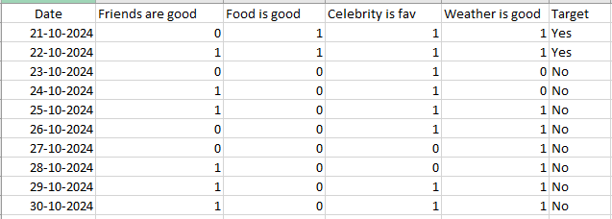
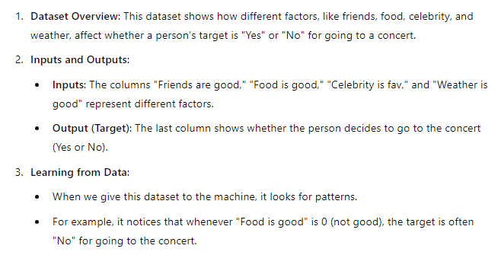
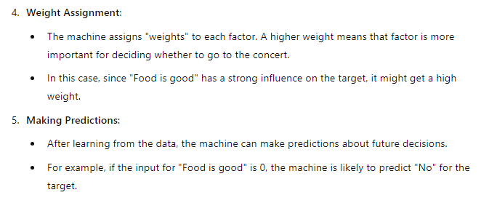
Understanding Weight:-

Slide 21
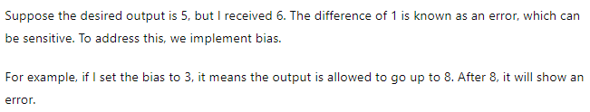
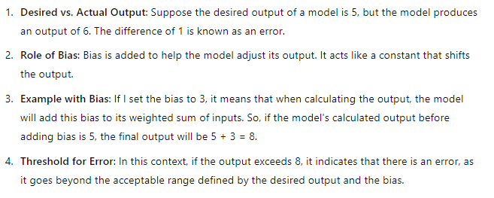
Understanding Bias:-

Slide 22
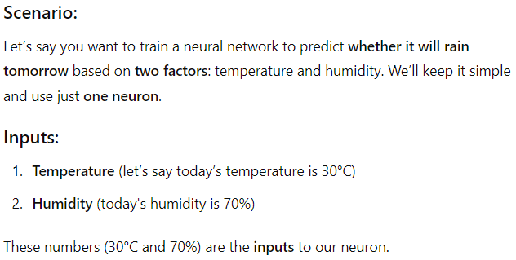

Slide 23
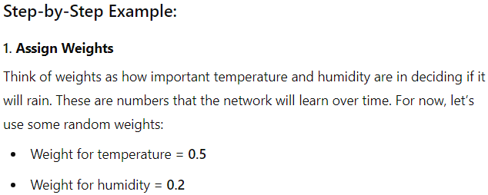
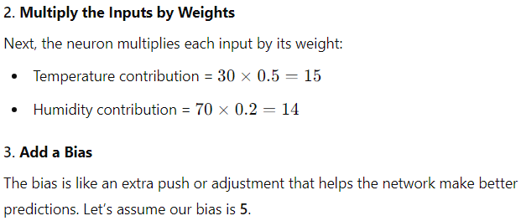

Slide 24
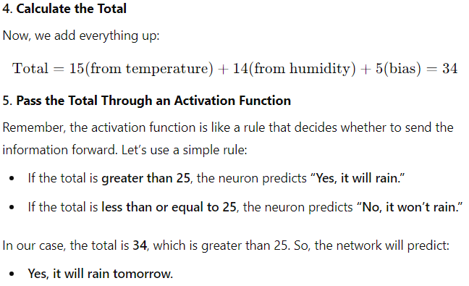

Slide 25
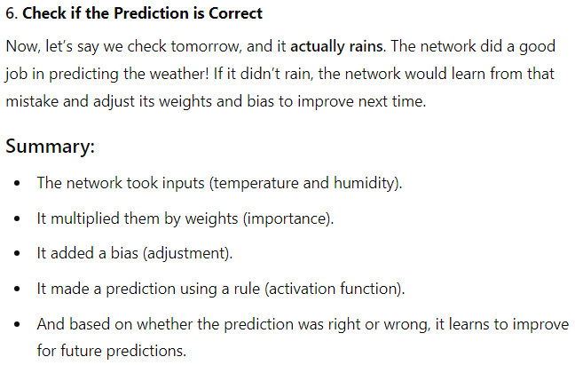

Slide 26
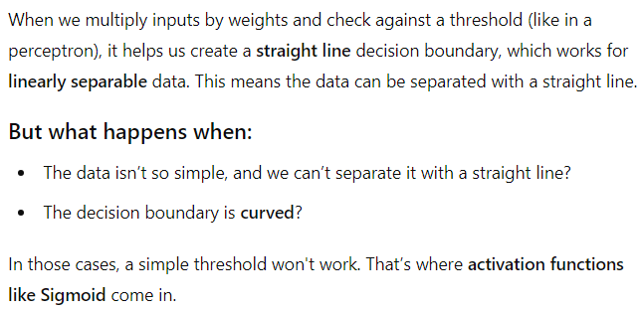
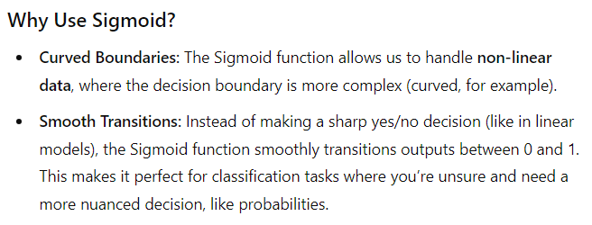
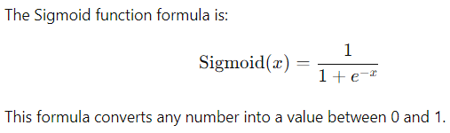

Slide 27
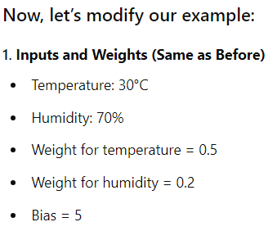
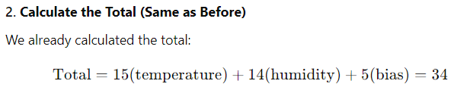

Slide 28
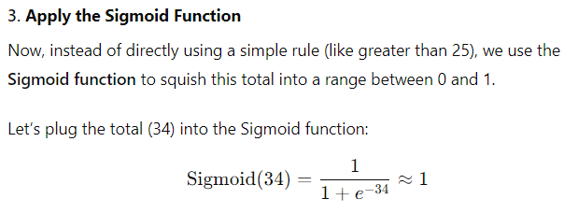



Slide 29



Slide 30


Basic Models

Slide 31




Slide 32



Slide 33



The key feature of an RNN is its memory: it remembers information from previous steps and uses it to make decisions about the current input. This makes RNNs good for tasks where the order of data matters, such as language translation, speech recognition, and predicting stock prices.

Slide 34



Slide 35



Slide 36



Slide 37





Slide 38



Slide 39


Slide 40


McCulloch-Pitts neuron

Slide 41



Slide 42



Slide 43



Slide 44


McCulloch-Pitts Neuron V/S Perceptron

Slide 45



Slide 46



Linear separability
A straight line (or plane) can be used to separate the two classes (i.e. the x’s from the o’s). In other words, a single decision surface can be used as the boundary between both classes.

Slide 47



Slide 48




Slide 49

Hebb Network

Slide 50



Slide 51



Slide 52



Slide 53

Hebb Network Defination:

Slide 54




Slide 55



Slide 56


Slide 57



Slide 58



Slide 59


Slide 60


Slide 61

Supervised Learning Network:-

Slide 62
Perceptron Networks:-
Up to this point, we've learned that a perceptron is another name for a neuron. However, as we move forward, it's important to note that while all perceptrons are neurons, not all neurons are perceptrons. In simple terms, a perceptron is a type of neuron, but there are other types as well, such as McCulloch-Pitts neurons, which work differently. The perceptron equation (y = f(wx + b)) is just one way to represent a neuron, but neurons come in different forms and have various functions.
While a perceptron primarily produces binary outputs (0 or 1), when the output is extended to probabilities, typically using a sigmoid activation function, it is often called a sigmoid neuron or sigmoid perceptron. This means that the perceptron and sigmoid neuron share a similar structure, but the key difference is in how they handle the output.
Perceptron: Produces a binary output (0 or 1) based on a threshold.
Sigmoid Neuron (or Sigmoid Perceptron): Produces an output in the range of 0 to 1, representing a probability, and uses the sigmoid function.
So, when you apply the sigmoid function to the perceptron model, it can indeed be called a sigmoid neuron or sigmoid perceptron. This flexibility allows perceptrons to be adapted for tasks that involve probability, like logistic regression.
In contrast, the McCulloch-Pitts neuron only deals with binary output and does not include probability-based decisions or non-linear activations like sigmoid.

Slide 63

Diagram of Perceptron:-

Slide 64

Adaptive Linear Neuron (Adaline)

Slide 65


Numericals:-

Slide 66



Slide 67




Slide 68




Multiple Adaptive Linear Neurons (Madaline)

Slide 69



Numericals:-

Slide 70



Slide 71




Slide 72



Slide 73

Backpropagation Network

Slide 74


Slide 75


Slide 76


Time Delay Neural Network

Slide 77


Slide 78



Functional Link Neural Network (FLNN)

Slide 79




Slide 80




Slide 81



Slide 82



Slide 83



Tree Neural Network (TNN)

Slide 84




Slide 85


Associative memory network

Slide 86


Training Algorithm for Pattern Association

Slide 87



Slide 88



Slide 89



Slide 90




Slide 91


Slide 92



Slide 93



Slide 94


Autoassociative memory network

Slide 95



Slide 96





Heteroassociative Memory Network

Slide 97


Bi – Directional Associative Memory

Slide 98



Slide 99


Hopfield Networks

Slide 100




Slide 101

Iterative associative memory network

Slide 102


Slide 103


Slide 104


Slide 105

Temporal Associative Memory Networks

Slide 106


